Slide 1
Efficient Video Object Detection for EV Charging Plug Type Identification in Real-World Scenarios
Phasuwut Chunnapiya, Porawat Visutsak
Department of Computer and Information Science
Faculty of Applied Science
KMUTNB
Notes:
Hello, I’m Phasuwut Chunnapiya. Today, I’ll be presenting our research titled “Efficient Video Object Detection for EV Charging Plug Type Identification in Real-World Scenarios.”

Slide 2
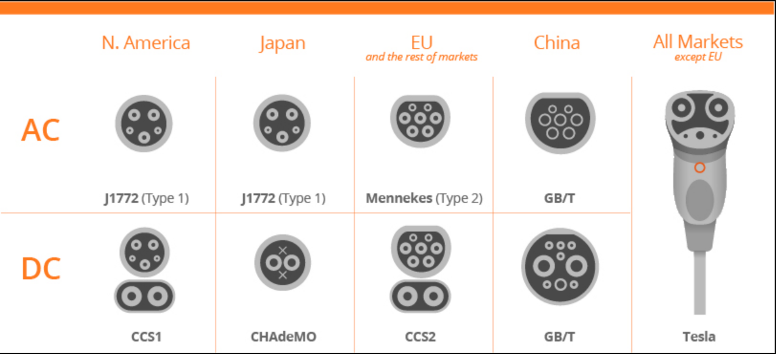
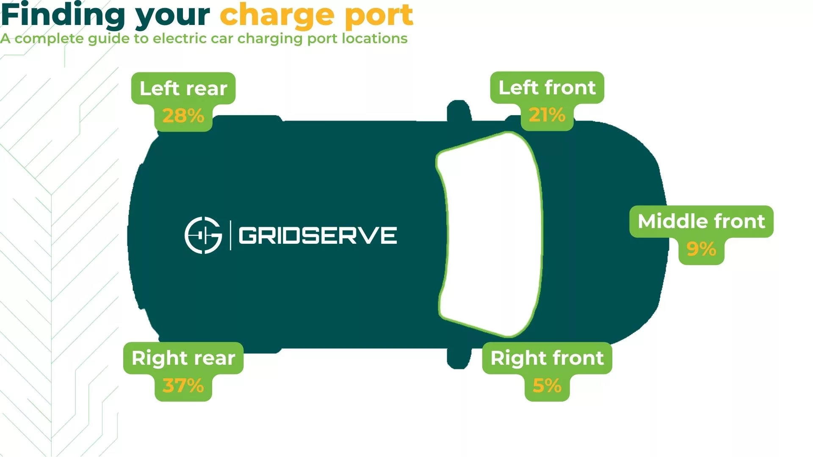
Introduction
Problem: Rapid EV adoption requires efficient charging systems, but varied plug types create challenges.
Objective: Develop a video object detection system for identifying EV plug types using YOLO models (V5-V8) on a custom dataset.
Application: User-friendly website for real-time EV plug detection.
Figure 1 shows electric car charging plugs around the world.
Figure 2 shows the location of EV charging plugs in Various plug locations.
Notes:
With the rapid growth of EVs, we need efficient charging solutions, but varied plug types are a challenge. Our goal is to create a detection system using YOLO models to identify plug types, and we made a website for real-time detection.

Slide 3
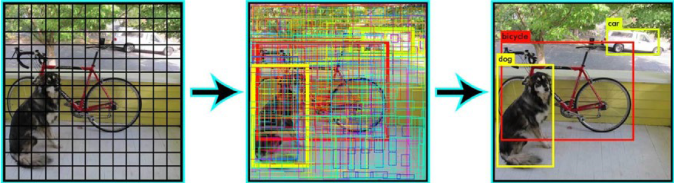
Literature Review
YOLO Architecture
YOLO (You Only Look Once) is a fast, single-stage object detection model that identifies multiple objects in a scene using bounding boxes via a CNN.
Figure 3 shows the Operating procedure of the YOLO algorithm with the NMS function.
Notes:
For object detection, we chose YOLO, which is fast and accurate. It uses a single-stage network to detect multiple objects with bounding boxes.

Slide 4
Literature Review
YOLO Version Comparisons
Version | Key Features
YOLOv5 | - Introduced CSPDarknet backbone. - Utilized Feature Pyramid Network (FPN) for improved feature extraction.
YOLOv6 | - Focused on efficiency with EfficientRep. - Implemented Rep-PAN for enhanced feature aggregation.
YOLOv7 | - Enhanced accuracy through Efficient Layer Aggregation Network (ELAN).
YOLOv8 | - Introduced C2f module for improved feature flow. - Employed anchor-free detection for simplicity. - Utilized smaller kernel sizes for faster inference.
Notes:
Each YOLO version has strengths:
YOLOv5: Efficient for limited resources.
YOLOv6: Very fast.
YOLOv7: Excellent accuracy.
YOLOv8: Balanced in speed and accuracy with anchor-free detection.

Slide 5
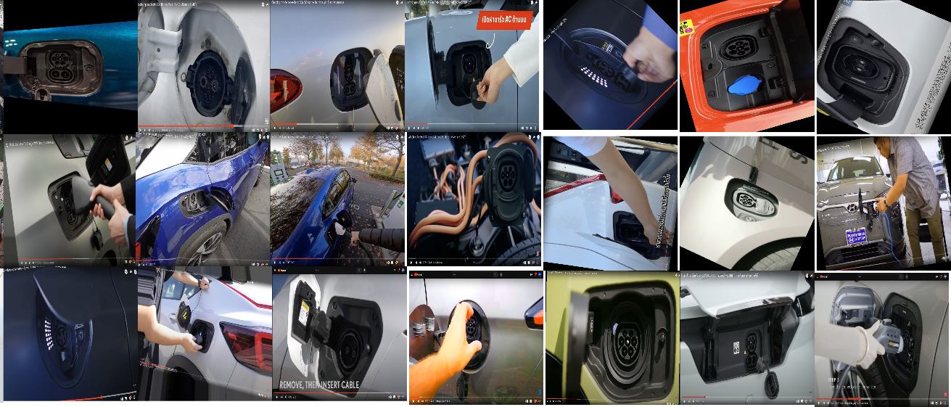
Dataset
Total Images: 109,902 images.
Classes: Five classes of EV sockets.
Augmentation: Using Albumentations for rotation, scaling, blur, and noise.
Split: Training, validation, and testing in an 8:1:1 ratio.
Sources: Public sites like Roboflow, Google, YouTube.
Figure 4 shows an overview of the dataset showing different sockets.
Notes:
Our dataset includes over 109,000 images divided into training, validation, and testing. Images were enhanced using techniques like rotation, scaling, and noise.

Slide 6
Dataset and Classes for EV Plug Types
Total Classes: 5
Plug Types:
CHAdeMO
AC Type 1
AC Type 2
DC CCS Type 1
DC CCS Type 2
Figure 5 shows electric car charging plugs in Thailand.
Notes:
We focused on five plug types:
CHAdeMO
AC Type 1
AC Type 2
DC CCS Type 1
DC CCS Type 2

Slide 7
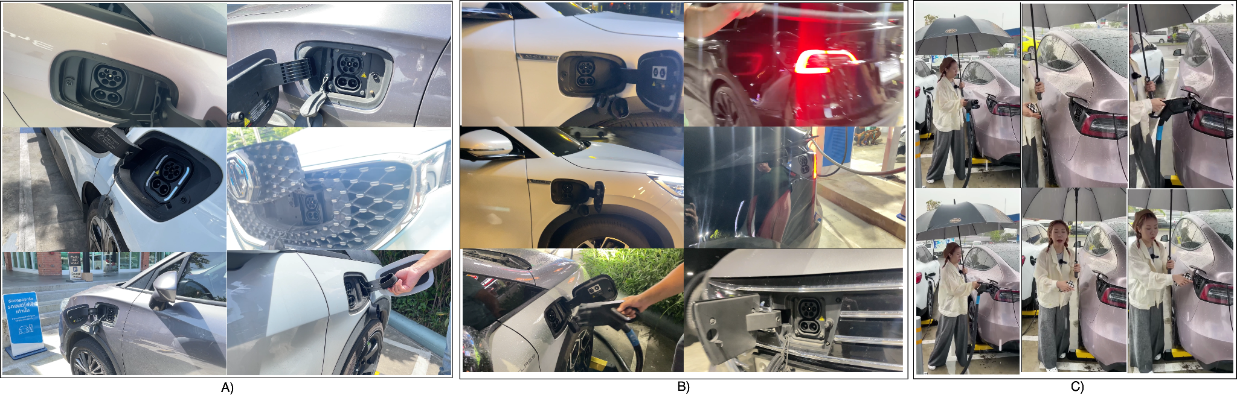
Real-world test video
Data collection locations:
Events: EV Expo and Motor Show in Thailand.
Locations: Gas stations, shopping malls, hotels.
Conditions:
Lighting: Daylight, night, rain.
Settings: Outdoor and indoor environments.
Figure 6 Video clips taken at actual locations at various charging stations.
Notes:
We tested our system with videos from real locations, like EV Expos, gas stations, and malls, and in different conditions such as day, night, and rain.

Slide 8
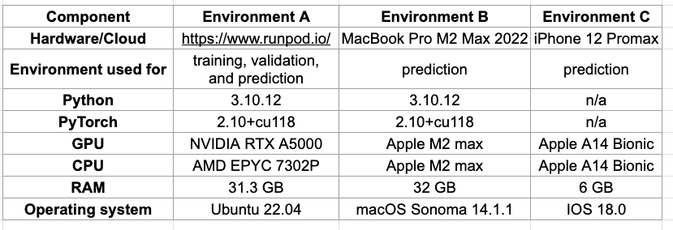
Experimental setting
Model training setup: Epochs =100 , batch size =32, image size =640, optional use default.
Training dataset: The same dataset is used for training four models.
Experimental environment: Refer to Figure 7 for visual representation.
Figure 7 show Enviroment used experimental
Component | Environment A | Environment B | Environment C
Hardware/ Cloud | https://www.runpod.io/ | MacBook Pro M2 Max 2022 | iPhone 12 Promax
Environment used for | training, validation, and prediction | prediction | prediction
Python | 3.10.12 | 3.10.12 | n/a
PyTorch | 2.10+cu118 | 2.10+cu118 | n/a
GPU | NVIDIA RTX A5000 | Apple M2 max | Apple A14 Bionic
CPU | AMD EPYC 7302P | Apple M2 max | Apple A14 Bionic
RAM | 31.3 GB | 32 GB | 6 GB
Operating system | Ubuntu 22.04 | macOS Sonoma 14.1.1 | IOS 18.0
Notes:
Our testing environments included cloud-based GPUs, a MacBook M2, and an iPhone 12. We used 100 epochs and a batch size of 32 for training.

Slide 9
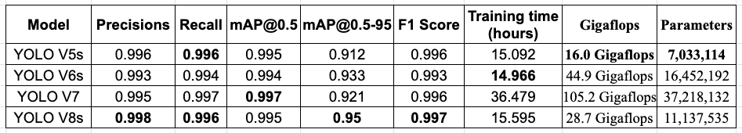
Results - YOLO Performance
Metrics Used:
mAP@0.5, mAP@0.5:0.95, precision, recall, F1 Score, Gigaflops.
Best Model:
YOLOv5s has the lowest Gigaflops and Parameters value among all YOLO
YOLOv6s has the lowest Training time value among all YOLO.
YOLOv7 has the highest mAP@0.5 of 0.997.
YOLOv8s had the highest mAP@0.5-0.95 of 0.95, precision of 0.998, and recall of 0.996.
YOLOv8s delivers the best balance of accuracy and efficiency.
Figure 8 shows the results of the experiments.
Notes:
Our main results show:
YOLOv5s is light and efficient.
YOLOv6s has the fastest training time.
YOLOv7 achieved the highest mAP@0.5.
YOLOv8s had the best overall precision, recall, and F1 scores.

Slide 10
Performance Comparison of YOLO Models
Metric Summary:
Gigaflops & Parameters:
Lightest Model: YOLOv5s
Heaviest Model: YOLOv7
Precision & Recall:
Best Performance: YOLOv8s (highest precision and recall)
Conclusion: YOLOv8s is ideal for accuracy-intensive tasks.
Notes:
Summarizing the models:
YOLOv5s is ideal for low-resource settings.
YOLOv8s provides the highest precision and recall.

Slide 11
Detection EV Socket on website
Website Development Overview
Framework: Next.js (version 14.2.7)
Prediction Library: "@tensorflow/tfjs" (version 4.21.0)
Rendering Method: Client-Side Rendering (CSR)
Predictions are processed directly on the client side
The website have YOLO V6s and YOLO V8s models used for prediction
Notes:
Our website, built with Next.js, allows users to detect EV plugs in real time using YOLOv6 or YOLOv8 models, with options to upload images, videos, or use the webcam.

Slide 12
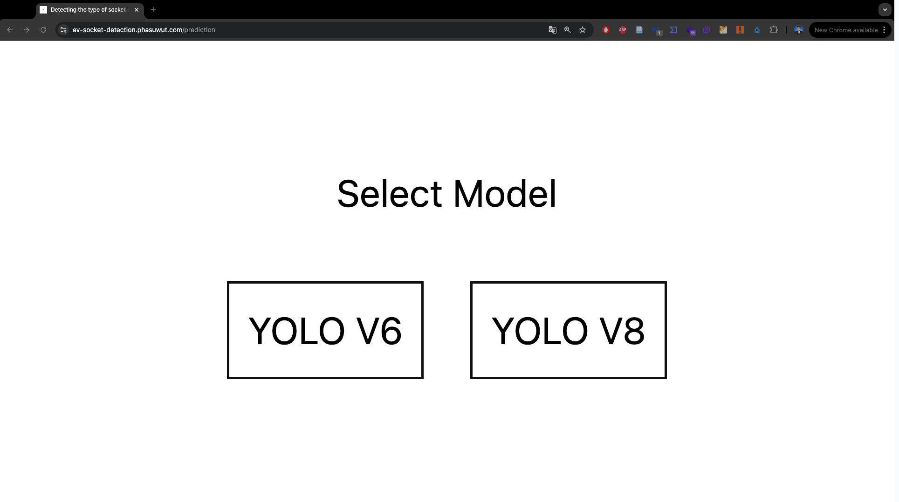
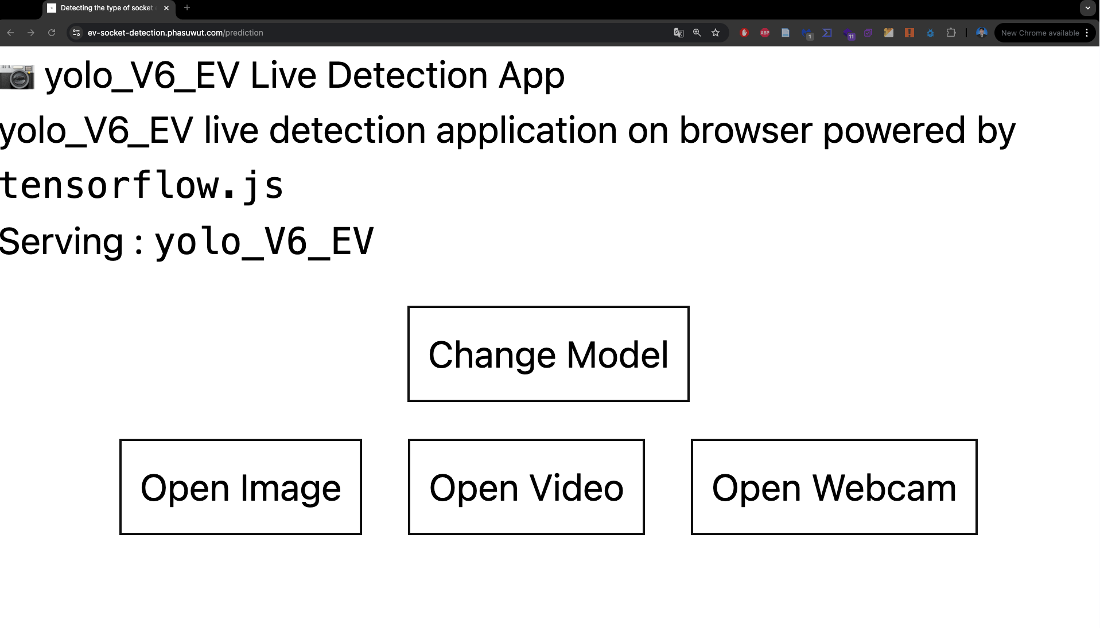
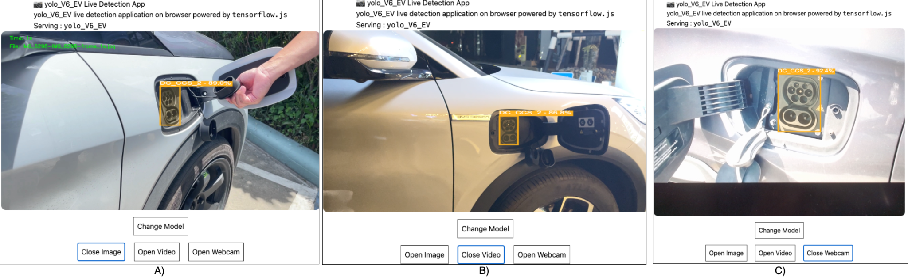
Detection EV Socket on website
Homepage (Figure 11):
Users can select between two models for prediction: YOLOv6 and YOLOv8.
Detection Modes (Figure 12):
Four buttons for user interaction: “Change Model”, “Open Image”, “Open Video”, and “Open Webcam”.
Detection Results (Figure 13):
Displays the results of the EV socket detection.
Figures 11 shows a button that can select a model
Figure 12 shows the menu
Figures 13 show the experimental results.

Slide 13
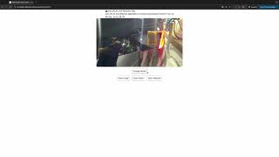


Detection EV Socket on website
Video and image test for ev-socket-detection
URL : https://kaggle.com/datasets/9d1ccb2f90198091526f5986311ffeb4e0de1fb6f672b49af2f50264f06584ee
Website Ddemo
URL : https://ev-socket-detection.phasuwut.com/prediction
Figure 9 shows the QR code of the Website.
Figure 10 shows the QR code of the Video and image test for ev-socket-detection
Video 1 shows a demo detection socket EV on the website.

Slide 14
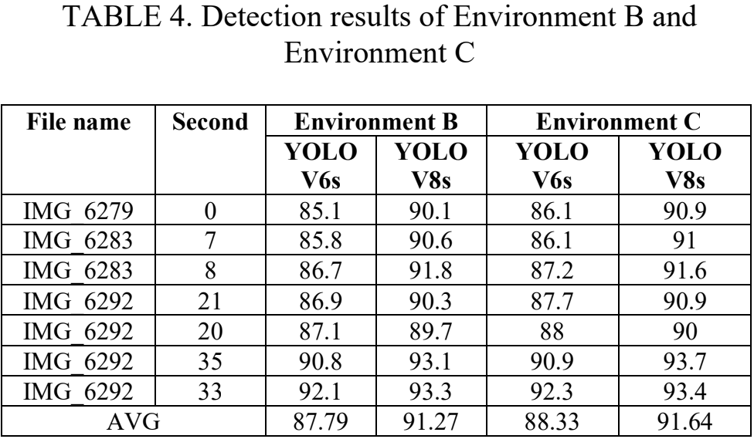
Results of detection EV Socket on website
Accuracy Improvement:
YOLOv8s outperforms YOLOv6s by:
3.49% in Environment B
3.31% in Environment C
Prediction Variability:
Environment B: Difference of 0.54%
Environment C: Difference of 0.37%
Model Stability: Demonstrates consistent performance across varying environments.
Figure 14 shows the Results of the detection EV Socket on the website.
Notes:
Testing on the website showed that YOLOv8s was around 3% more accurate than YOLOv6s in various environments, with stable results across conditions.

Slide 15
Conclusions
Study Focus: YOLO-based models for video object detection in automatic EV charger robots.
Key Findings:
YOLOv5s: Most efficient; suitable for low-resource devices; comparable metrics to YOLOv7.
YOLOv6s: boasts the fastest training time.
YOLOv7: Strong mAP@0.5 (0.997); resource-intensive.
YOLOv8s: Highest mAP@0.5:0.95 (0.95), Precision (0.998), F1 Score (0.997).
Real-World Testing:
85.08% accuracy in detecting EV sockets in real time.
Web implementation allows cross-device predictions.
Recommendation: Use YOLOv5s for resource-constrained environments.
Notes:
To conclude:
YOLOv8s is best for accuracy.
YOLOv5s is ideal for efficiency on low-resource devices. We achieved 85% accuracy in real-time detection.

Slide 16
Thank you
ref : [x]
Notes:
Thank you for your attention. I had be happy to answer any questions.

